Slide 1
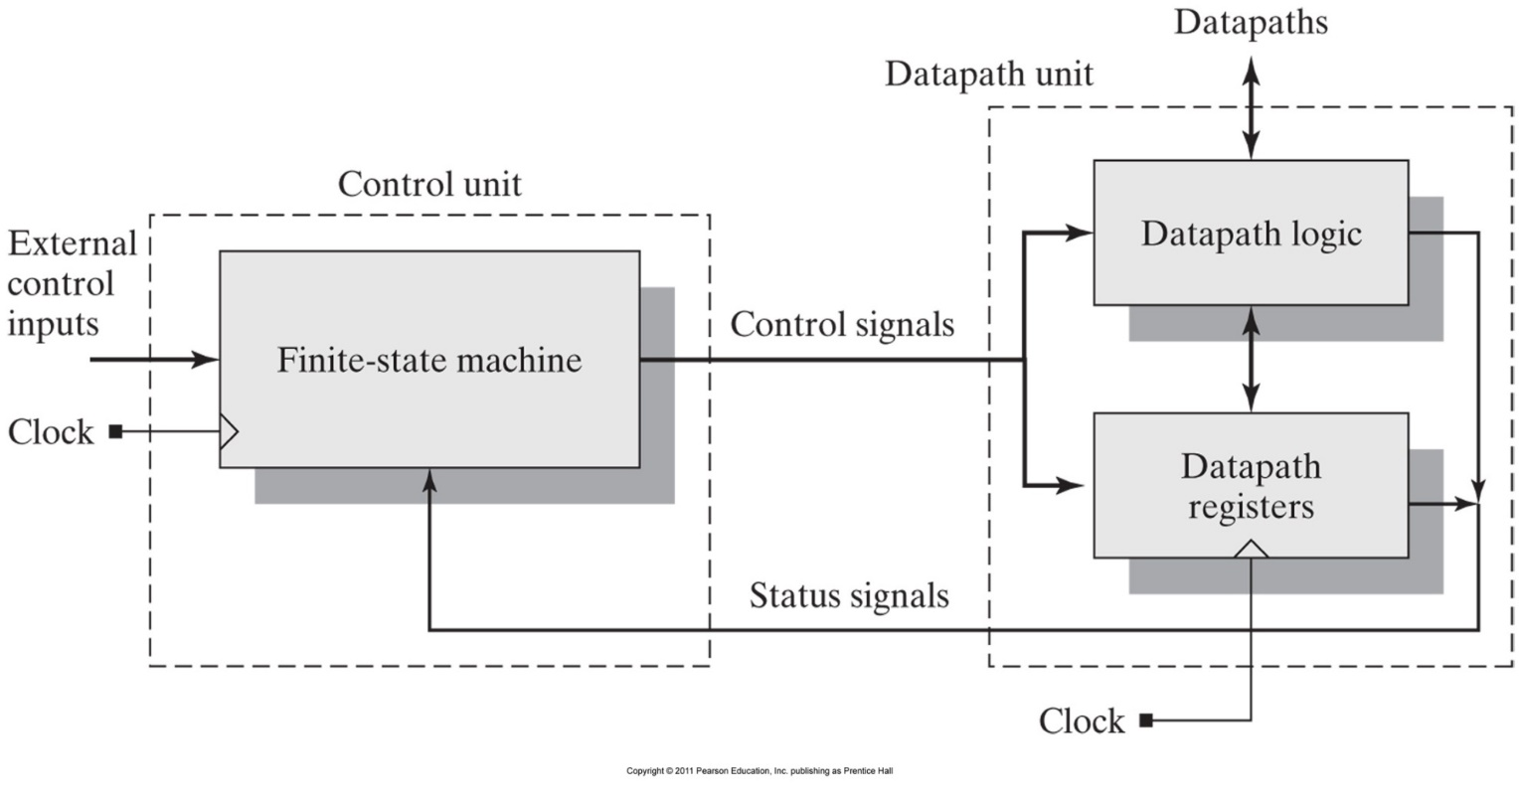
Topic 10
Finite State Machines &
(ASM Charts)-(2/2)
國立高雄大學電機工程學系
陳春僥
cychen@ieee.org
June 17, 2021

Slide 2
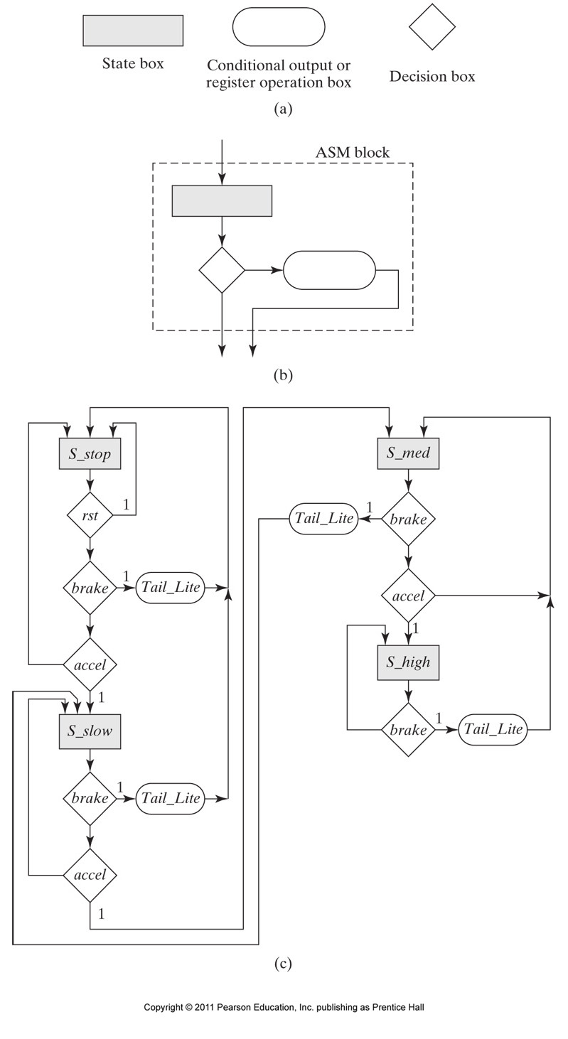
Algorithmic State Machine (ASM) Chart

Slide 3
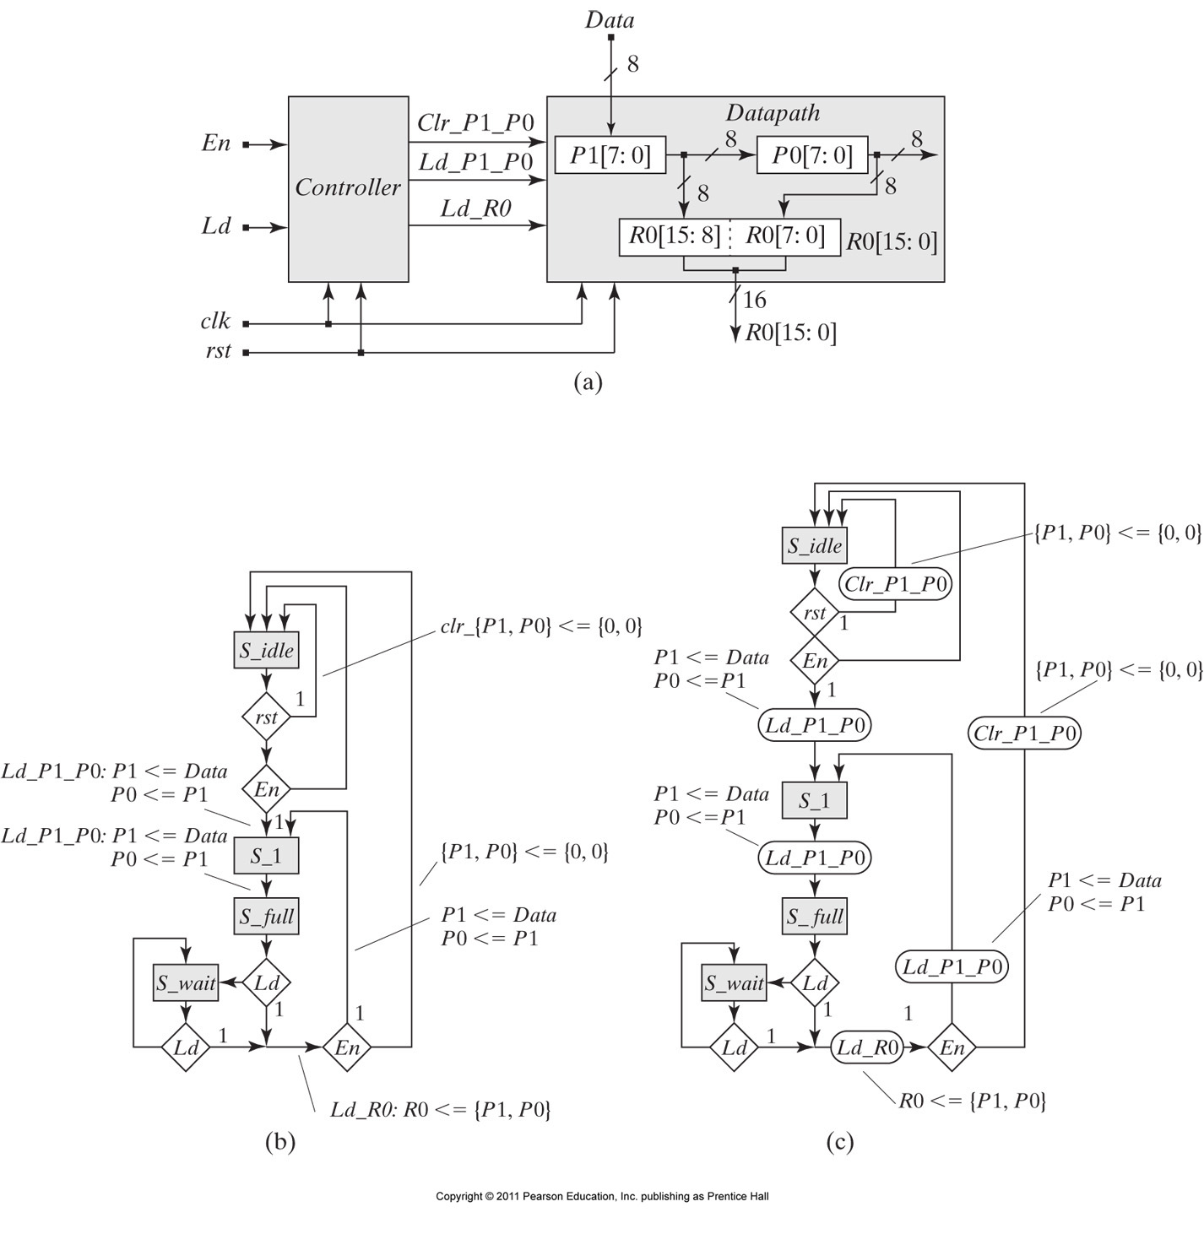
Two-Stage Pipelined Register

Slide 4
Two-Stage Pipelined Register

Slide 5
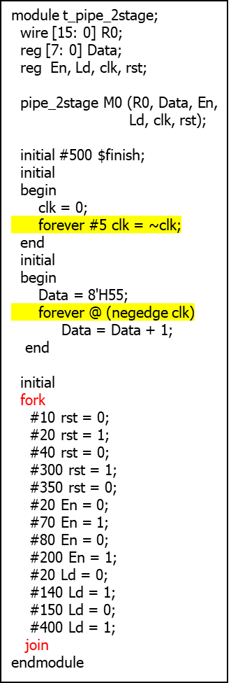
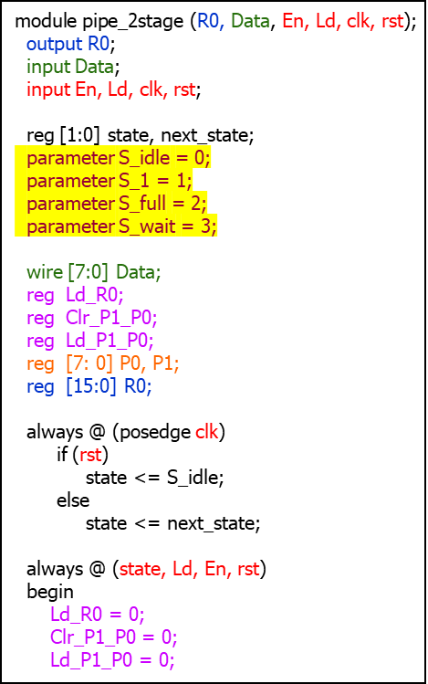
Two-Stage Pipelined Register
3
S_wait: if (Ld)
begin
Ld_R0 = 1;
if (En)
begin
next_state = S_1;
Ld_P1_P0 = 1;
end
else
begin
next_state = S_idle;
Clr_P1_P0 = 1;
end
end
default: next_state = 2'bx;
endcase
end
case (state)
S_idle: if (rst)
begin
next_state = S_idle;
Clr_P1_P0 = 1;
end
else if (En)
begin
next_state = S_1;
Ld_P1_P0 = 1;
end
else
Clr_P1_P0 = 1;
S_1: begin
next_state = S_full;
Ld_P1_P0 = 1;
end
S_full: if (Ld == 0)
next_state = S_wait;
else
begin
Ld_R0 = 1;
if (En)
begin
next_state = S_1;
Ld_P1_P0 = 1;
end
else
begin
next_state = S_idle;
Clr_P1_P0 = 1;
end
end
always @ (posedge clk)
begin
if (Clr_P1_P0)
begin
P1 <= 0;
P0 <= 0;
end
if (Ld_R0)
begin
R0 <= {P1, P0};
end
if (Ld_P1_P0)
begin
P1 <= Data;
P0 <= P1;
end
end
endmodule
1
4
2
5

Slide 6
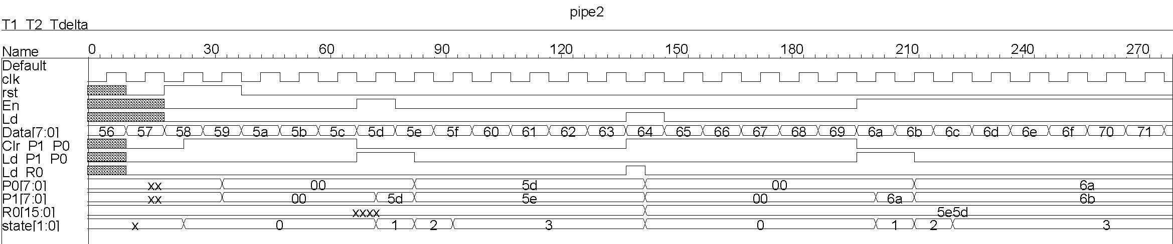

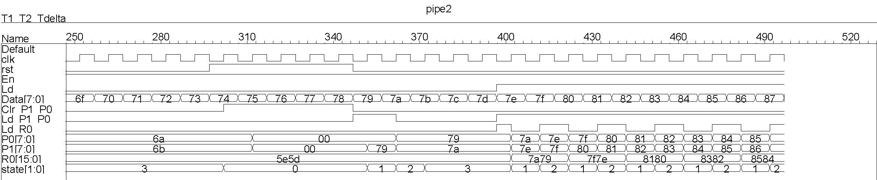
Two-Stage Pipelined Register

